Slide 1
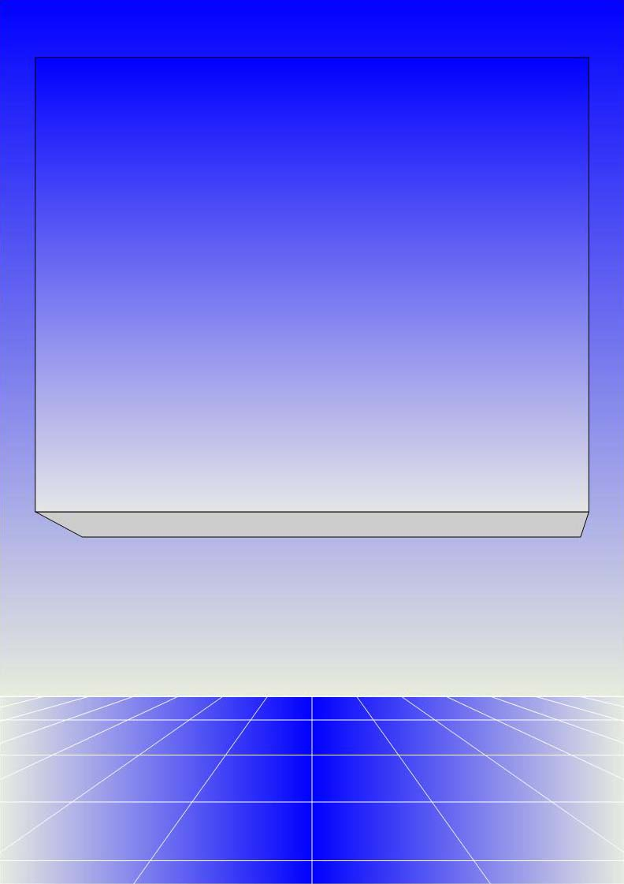
CO2301 - Games Development 1
Week 3
Game Agents 2
Gareth Bellaby

Slide 2

    Game Agents continued
    - sensing

Slide 3
Books and articles
http://www.introgamedev.com/resource_gpg5.html
http://www.gdconf.com/conference/proceedings.htm
2007, 2006 and 2005 proceedings available.
http://www.gamasutra.com/features/gdcarchive/
also includes European conference

Slide 4
Basic Game Agent loop
think
sense
act
version 1

Slide 5
Sensing
Sensing is the obtaining of information about the world.
Vision
Hearing
Touch (being hit for example)
Sensing also includes communication with other Software Agents.

Slide 6
Sensing
Gaining information about the world.
A game agent could obtain perfect information about the world:
  cheating is disliked when it is obvious
  agent should have human limitations
  agent should react in the way the player expects, e.g. a NPC in a FPS should use the same senses as a human

Slide 7
Sensing - Vision
Visibility testing is computationally expensive. Consider the expense of having all sensitive agents in the game continually monitoring visual cues.
Instead:
  limit (e.g. thresholds, view distance, only consider things that the agent is interested in)
  periodic checks

Slide 8
Sensing - Vision
An efficient vision algorithm would only consider:
objects that the agent is interested in
objects within the viewing distance of the agent
objects within the viewing angle of the agent
objects within the unobscured LOS of the agent
Realism is expensive, e.g. consider a partially revealed object...

Slide 9
Sensing - Hearing
Some similarities to vision.
Other considerations that need to be taken into account:
ambient noise
occlusion
sound propagation
surfaces

Slide 10
Sensing - Hearing
A realistic model is expensive.
A typical approach is therefore to use event-driven notification. Events produce messages. An action gives rise to a sound, e.g. footsteps, a door opening.
Keep things simple by using a distance calculation + bounding boxes.
Use some of the techniques developed for graphics.

Slide 11
Sensing - Communication
Agents can be sociable.
Agents can communicate with one another.
As with hearing, events produce messages.

Slide 12
Sensing - Reaction times
A game agent can react instantaneously.
Need to build in a reaction time.
Use a simple delay timer.

Slide 13
Thinking
Take in input (sensing)
Decision making.
Reasoning.
Rationality.
Think using a combination of innate knowledge and the input
leads to action

Slide 14
Thinking
Pathfinding
Conceptual search
Production rules
Finite State Machines

Slide 15
Thinking
Expert Systems
Machine Learning
Flip-Flopping

Slide 16
Acting
Carrying out the results of the decision.
For example:
change location
play an animation
play a sound effect
use a weapon
communicate with another agent

Slide 17
Acting
Acting is the only part of the sense-think-act cycle that can be revealed to the player.
Therefore, try to make something obvious happen.
Why bother doing something without revealing it to the player? The action doesn't have to material consequences, e.g. play a sound commenting on the situation or play an appropriate animation.

Slide 18
Advanced Game Agent loop
think
act
sense
memory/
learning

Slide 19
Learning and Memory
Is memory worthwhile for most game agents?
Is learning worthwhile for most game agents?

Slide 20
Learning and Memory
Memory can be used to:
avoid having to repeat a calculation
to predict future outcomes
to improve the agent's reasoning
Knowledge doesn't have to be stored in the agent. It can be stored in the world's data structure.

Slide 21
Agents and Humans
For some tasks it is difficult to create a game agent that is as good as a human player, e.g. strategic analysis or co-operative behaviour.
For some tasks it is easy to create a game agent that is much better than a human player, e.g. an FPS agent.

Slide 22
Agents and Humans
You may need to undermine the agent, e.g. less accurate, less able to sense the world, worse memory, etc.
In some games the advantages which a game agent enjoys are used to counterbalance the disadvantages which a game agent suffers.
Is this a good idea?

